Slide 1
Nose Shape
By: Brandon Henry

Slide 2

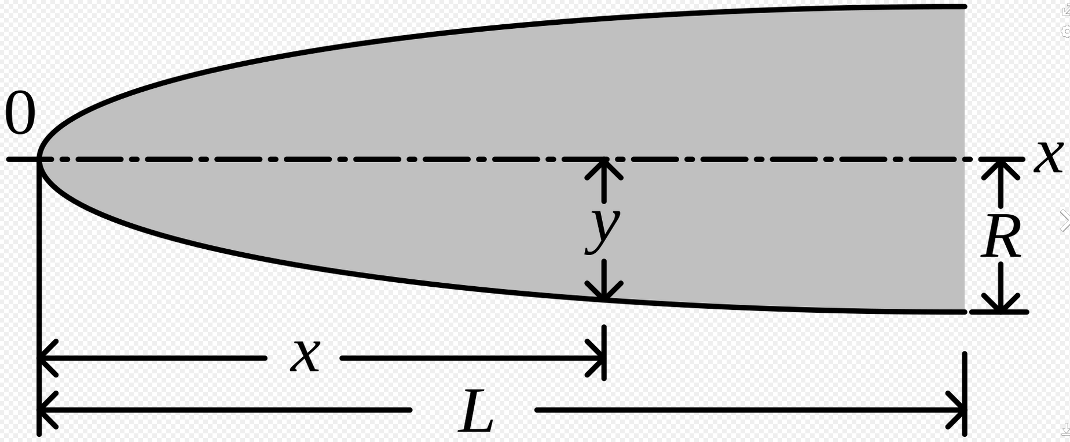
Rounded Noses
Since we’re worried about lap time, we want the plane to have as little drag as possible. Rounded noses push the air in front of them allowing it to roll over the fuselage with little resistance. In a Subsonic speed setting this is extremely useful (this is why commercial airplanes use this nose model)

Slide 3
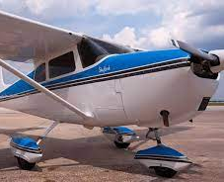
Candidate 1 (Cessna Nose)
Averages 140 mph (120 knots)
Extremely Blunt nose
Parasite Drag: 91.2 lbf
Takeoff Distance: 1,620 feet
Drag Coefficient: .029
Cessna 172

Slide 4
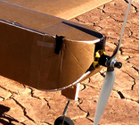

Candidate 1
With a nose design like this we have the propeller mounted on the blunt nose itself, which can greatly aid with the thrust of plane, along with aiding in overall stability. One thing we will need to keep in mind is the fact that we need to make sure that our pilot dummy can see out of a window at the front of the plane

Slide 5
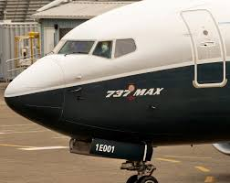
Candidate 2 (Boeing 737)
Averages 601 mph (Mach .79)
Drag Coefficient: .031
Sharpens at the end of the Nose
Takeoff Distance: 9,700 ft
Boeing 737 Max

Slide 6
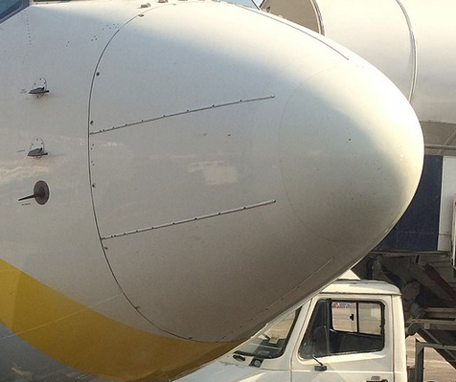
Candidate 2
These blunt noses are modeled more similarly to everyday commercial aircrafts. These shapes are more parabolic and will push more air out of the aircraft's way, as a way of dealing with drag, compared to Candidate 1. This shape will make it easy for manufacturing to make a small window for the plane's pilot to see through

Slide 7
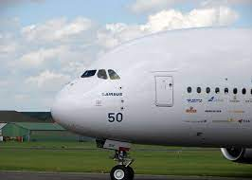
Candidate 3 (Airbus A380)
Averages 634 mph (Mach .85)
Parasite Drag: 5,000 lbf
Take off distance: 9,800 feet
Drag Coefficient: .368
Airbus A380

Slide 8
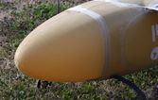
Candidate 3
Similar to Candidate 2 the nose shape will model another commercial aircraft. This shape will make it easy for manufacturing to make a small window for the plane's pilot to see through

Slide 9
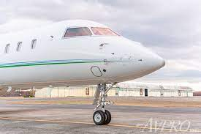
Candidate 4 (Bombardier Global 6000)
Averages 590 mph (Mach .85)
Takeoff distance: 6,476 feet
Like Candidate 2, but sharper edge
Airbus A380

Slide 10
Candidate 4
While on the pointier side of the considered candidates the Global 6000 still performs the same characteristics of the previous candidates, but can also serve as a hybrid between the blunt nose and pointy nose architects

Slide 11
Summary
Each design will need to be slightly modified, so that a window can be made for our dummy pilot.

Slide 12
Order of Best Options
Candidate 1 (Cessna model)-has greatest stability
Candidate 3 (A380)- easiest to manufacture
Candidate 2 (737)- Decent Drag Coefficient
Candidate 4 (Global 6000)- Slimmest design and would require the least amount of material

Slide 13
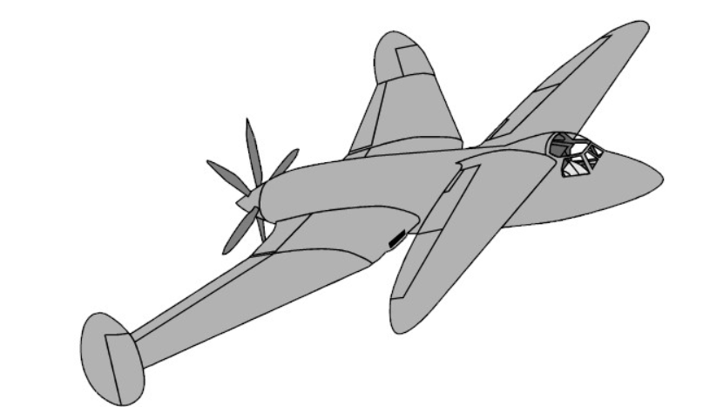
Tandem Wings Design
Tandem Wings provide a high lift while maintaining relatively good stability, due to the increased amount of wing surface area from having two pairs of wings. A potential drawback in this design is the fact that stability is not as stable as other potential designs. Having Tandem wings means that the Plane does not need to have as large of a wingspan. (keep in mind that this design approach require more material overall)
Reference: Design and Optimization of a Tandem Wing Aircraft - KSCST, www.kscst.org.in/spp/45_series/SPP45S/02_Exhibition_Projects/143_45S_BE_4055.pdf. Accessed 5 Oct. 2023.

Slide 14
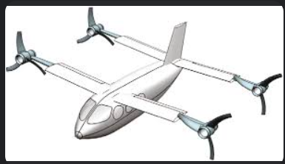
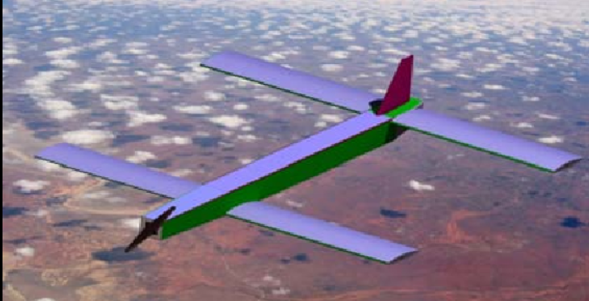
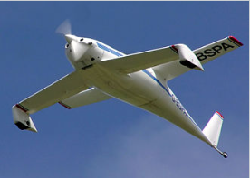
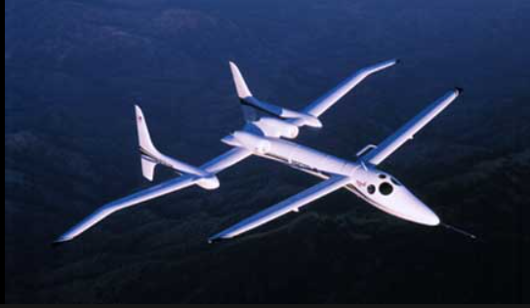
Tandem Wing Designs

